Slide 1
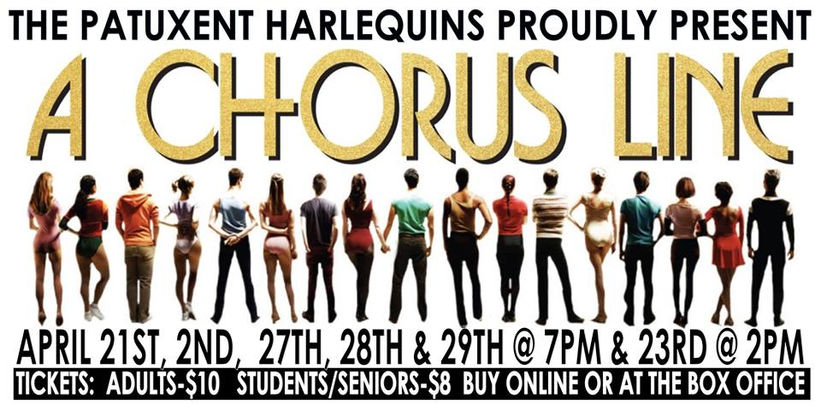
Costumes

Slide 2
ALL MALES MUST READ THIS
ALL BOYS IN THIS SHOW GOING ON STAGE THAT WILL BE DANCING HAVE TO BUY SOME SORT OF MENS DANCE BELT .
https://www.discountdance.com/dancewear/style_ME821.html?pid=26151&Shop=Style&SID=1100419565
https://www.discountdance.com/dancewear/style_ME820.html?pid=26149&Shop=Style&SID=1100905511
ALL SO DEPENDING ON WHAT YOU ARE WEARING SOME OF THE OUFITS ALREADY HAVE THE DANCE BELTS BUILT IN BUT THAT WOULD ONLY BE A FEW OR NONE.
WHY: Dance belts were developed and considered desirable for male dancers and others to wear because (1) various choreographic moves can otherwise result in pain or possibly even injury to the male genitalia which are not supported nor held snugly in place against the lower abdominal area, as well as (2) skin-tight, body-hugging ballet tights would otherwise reveal the contours of the male dancer's anatomy to a degree of detail which could be considered distracting to the audience
SO NO COMPLAINING ….. AND IF YOU THINK YOU DON'T NEED ONE THEN WE WILL GO THROUGH THE AWKWARD STAGES OF ME GETTING ONE FOR YOU.

Slide 3
ALL FEMALES MUST READ THIS
ALL FEMALES GOING ON STAGE DANCING MUST HAVE TIGHTS AND SPANKS ON. THE COLOR AND WHAT TYPE OF CUT IT IS MAY VARY DEPENDING ON WHAT YOU ARE WEARING BUT THAT’S ABOUT IT. YOU HAVE THREE OPTIONS ON NEXT SLIDE.
OPTION #1 : BODY TIGHTS
OPTION #2 : TIGHTS AND CAMISOLE
OPTION #3 : TIGHTS AND DANCE BRA (CLEAR STRAPS AND BACK)
SHOES ARE CHARACTER HEELS SOME OF YOU MIGHT HAVE THEM SOME MAY NOT. IF YOU GET NUDE TIGHTS YOU,GET NUDE HEELS TO MATCH. IF YOU HAVE BLACK TIGHTS, BLACK HEELS. SKIN TONED TIGHTS NEED TO HAVE MATCHING HEELS. All Character shoe links are 2" heels and above because at an audition you would not wear a heel size smaller than that. If you can not walk in that heel size or already have character shoes. Then please come talk to me about it and we can figure it out.
https://www.discountdance.com/dancewear/style_THP330.html?pid=22726&Shop=Style&SID=1100900553
https://www.allaboutdance.com/dance-clothing/product-view/style_T3415.html?SID=1100899235&mainCategory=shoes&styleOne=JAZZSHOESAAD&styleTwo=CHARACTERSHO&PageNumber=1&ageGroup=none
https://www.allaboutdance.com/dance-clothing/product-view/style_T3200.html?SID=1100899235&mainCategory=shoes&styleOne=JAZZSHOESAAD&styleTwo=CHARACTERSHO&PageNumber=1&ageGroup=none
https://www.allaboutdance.com/dance-clothing/product-view/style_CH53.html?SID=1100899235&mainCategory=shoes&styleOne=JAZZSHOESAAD&styleTwo=CHARACTERSHO&PageNumber=1&ageGroup=none

Slide 4
ALL FEMALES MUST READ.....
OPTION #1 :BODY TIGHTS
https://www.discountdance.com/dancewear/style_N236.html?pid=8115&Shop=Style&&skey=&search=true&SortOrder=P&SID=1100965287
https://www.discountdance.com/dancewear/style_T6500.html?pid=22265&Shop=Style&&skey=&search=true&SortOrder=P&SID=1100965287
http://www.dancewearsolutions.com/tights/body/1818.aspx?position=0
OPTION #2 : TIGHTS + CAMISOLE
https://www.discountdance.com/dancewear/style_T5400.html?pid=7806&Shop=Style&&skey=&search=true&SortOrder=P&SID=1100965287
https://www.allaboutdance.com/dance-clothing/product-view/style_1915.html?SID=1100972392&mainCategory=tights&PageNumber=1&ageGroup=none
https://www.allaboutdance.com/product-view/style_A31X.html?pid=18263&Shop=Style&?skey=plus&search=true&skey=plus&search=true&SID=1104986651&ageGroup=none
CAMISOLE
https://www.allaboutdance.com/dance-clothing/product-view/style_N234.html?SID=1104977384&mainCategory=BODYWEAR&styleOne=UNDERAAD&PageNumber=3&ageGroup=none
https://www.discountdance.com/dancewear/style_TB49.html?pid=134&Shop=Style&SID=1104973248
https://www.allaboutdance.com/dance-clothing/product-view/style_N234W.html?SID=1104984598&mainCategory=BODYWEAR&styleOne=UNDERAAD&PageNumber=1&ageGroup=none
OPTION #3 : TIGHTS + DANCE BRA
https://www.discountdance.com/dancewear/style_T5400.html?pid=7806&Shop=Style&&skey=&search=true&SortOrder=P&SID=1100965287
https://www.allaboutdance.com/dance-clothing/product-view/style_1915.html?SID=1100972392&mainCategory=tights&PageNumber=1&ageGroup=none
https://www.allaboutdance.com/product-view/style_A31X.html?pid=18263&Shop=Style&?skey=plus&search=true&skey=plus&search=true&SID=1104986651&ageGroup=none
DANCE BRA
http://www.dancewearsolutions.com/accessories/undergarments/bw274.aspx?position=2
https://www.allaboutdance.com/dance-clothing/product-view/style_274.html?SID=1107099309&mainCategory=BODYWEAR&styleOne=UNDERAAD&styleTwo=BRASAAD&PageNumber=1&ageGroup=none
https://www.discountdance.com/dancewear/style_287.html?pid=6499&Shop=Style&SID=1107099882
https://www.discountdance.com/dancewear/style_353.html?TopCat=UG&cat=&Shop=Style&SID=1107099882

Slide 5
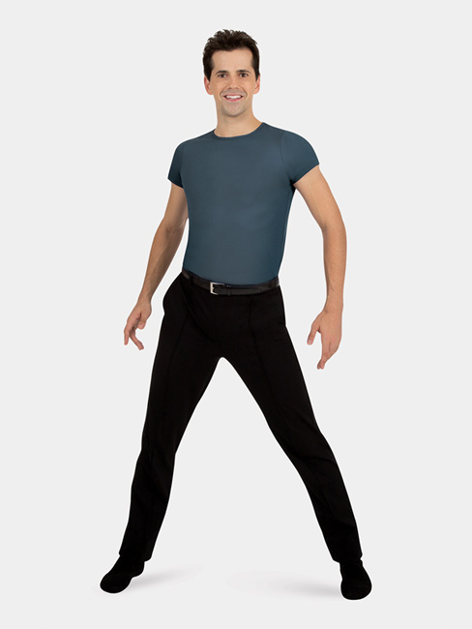
Zack- Alex Sledge
Shirts
Nice shirt
Pants (black)
https://www.allaboutdance.com/dance-clothing/product-view/style_M1000.html?SID=1100437219&mainCategory=mens-and-unisex&PageNumber=1&ageGroup=none#
Shoes black

Slide 6
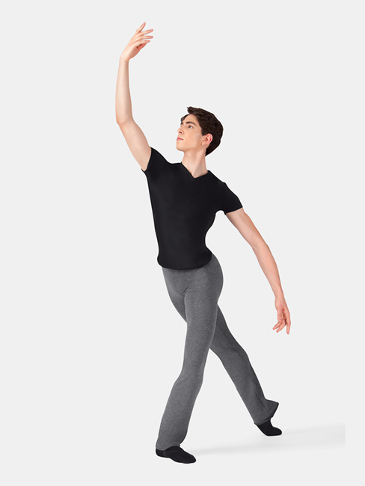
Larry- Hunter Marsh
Long sleeves (black)
Pants ( Black)
https://www.allaboutdance.com/dance-clothing/product-view/style_CL825.html?SID=1100433233&mainCategory=mens-and-unisex&styleOne=PANTSAAD&PageNumber=2&ageGroup=none
Shoes (Black)
http://www.dancewearsolutions.com/boys_and_men/shoes_and_tights/b80.aspx?position=1

Slide 7
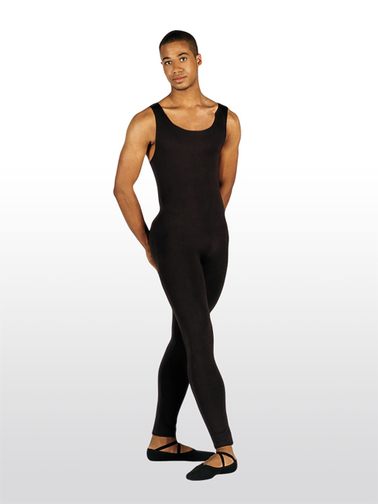
Don Kerr-Hunter Youngblood
Unitard
https://www.allaboutdance.com/dance-clothing/product-view/style_AB21.html?SID=1100437219&mainCategory=mens-and-unisex&PageNumber=1&ageGroup=none
Some kind of t shirt over it .
Shoes
http://www.dancewearsolutions.com/boys_and_men/shoes_and_tights/b80.aspx?position=1

Slide 8
Maggie Winslow-Alexia Smith
Leotard
https://www.discountdance.com/dancewear/style_N8460.html?pid=26122&Shop=Style&&skey=&search=true&SortOrder=P&SID=1106741265
Leggings (brown)
http://www.dancewearsolutions.com/bottoms/cl3801.aspx?position=4
Tights
Shoes

Slide 9
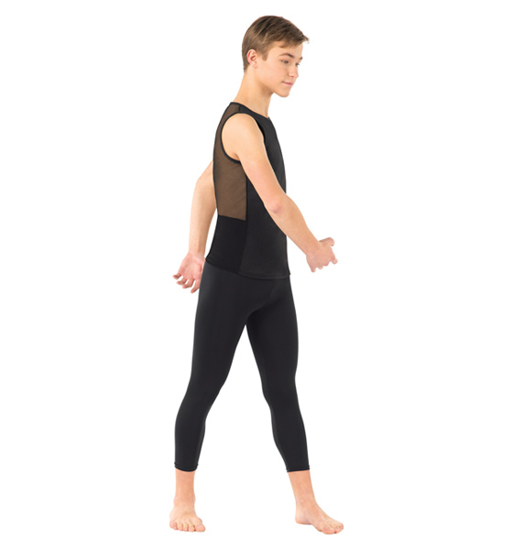
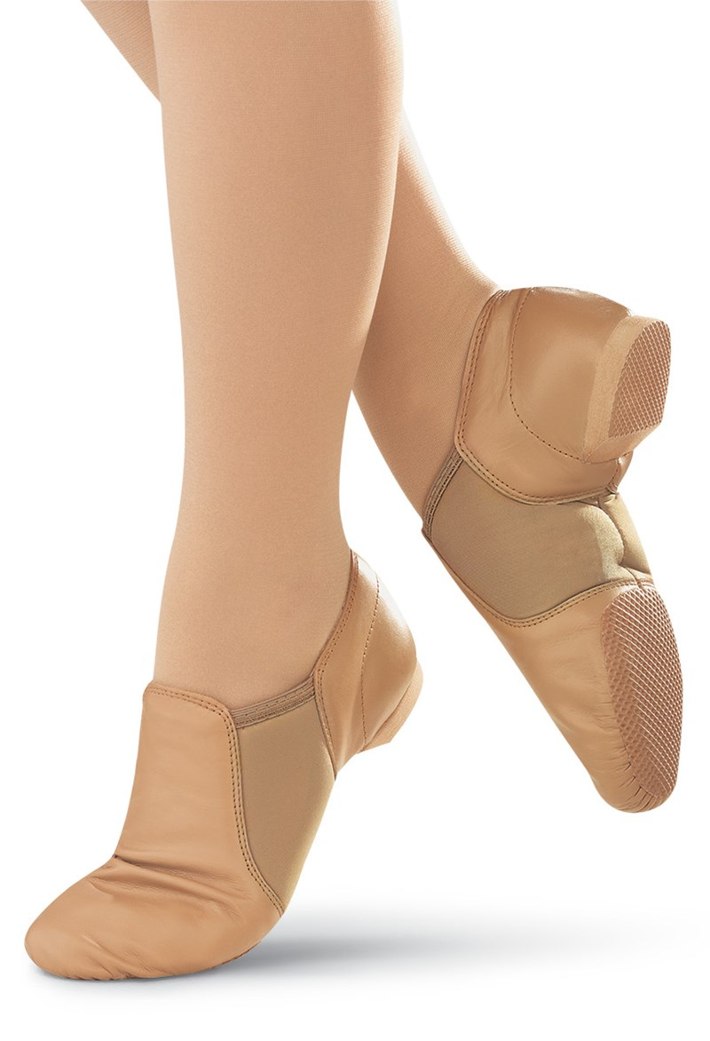
Mike Costa-Mitchell Richman
Shirt (white)
https://www.discountdance.com/dancewear/style_ME811.html?TopCat=&cat=&Shop=
Pants (Dark blue)
https://www.discountdance.com/dancewear/style_ME801.html?pid=26134&Shop=Style&&skey=&search=true&SortOrder=N&SID=1100437336
Shoes (nude)
http://www.dancewearsolutions.com/boys_and_men/shoes_and_tights/b80.aspx?position=1

Slide 10
Connie- Jenni O'Conner
Leotard (light blue)
http://www.dancewearsolutions.com/leotards/mt757-clearance.aspx?position=49
https://www.discountdance.com/dancewear/style_N5500.html?pid=10098&Shop=Style&SID=1100544350
Tights (white or skin color)
Leg warmer and sweater (black)
https://www.allaboutdance.com/product-view/style_AW116.html?pid=26374&Shop=Style&?skey=new:&search=true&skey=new:&search=true&SID=1100520936&ageGroup=none
1.https://www.allaboutdance.com/dance-clothing/related/style_AW112.html?mainCategory=NEW&styleOne=&styleTwo=&styleThree=&brand=&color=&SID=1100520936&search=true

Slide 11
Greg Gardner- Matt becker
Suspender pants
https://www.allaboutdance.com/dance-clothing/product-view/style_SIL5005.html?SID=1100437219&mainCategory=mens-and-unisex&PageNumber=1&ageGroup=none
White skin tight shirt
https://www.discountdance.com/dancewear/style_N7085.html?TopCat=&cat=&Shop=
Turtle neck
Shoes (black)
http://www.dancewearsolutions.com/boys_and_men/shoes_and_tights/b80.aspx?position=1

Slide 12
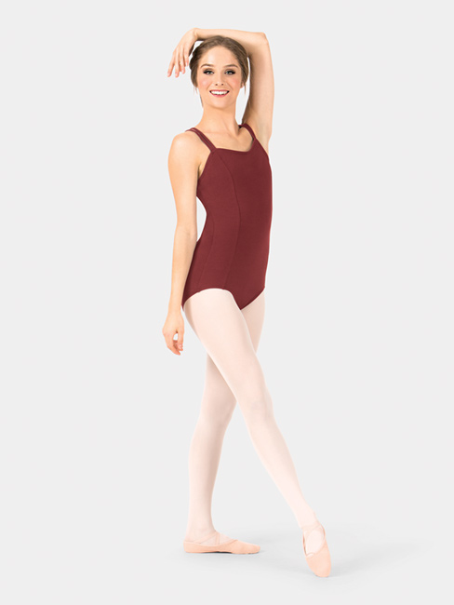
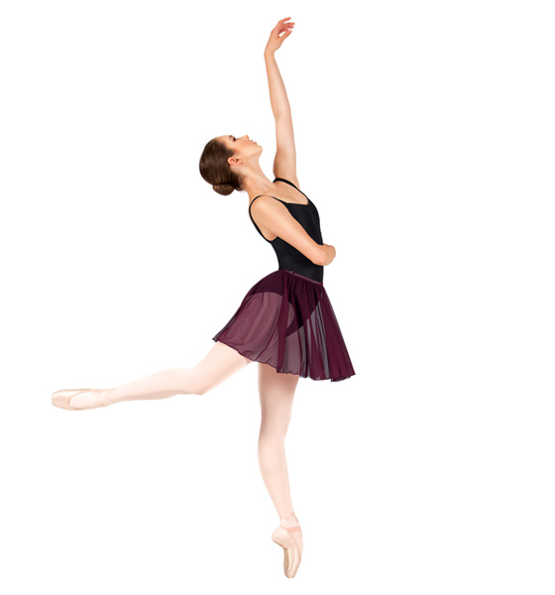
Cassie Ferguson- Ashlyn Francella
Leotard (red)
https://www.discountdance.com/dancewear/style_SPX8102.html?TopCat=&cat=&Shop=
https://www.allaboutdance.com/dance-clothing/product-view/style_TH5526.html?SID=1100939535&mainCategory=BODYWEAR&styleOne=BALLETAAD&styleTwo=LEOTARDSAAD&PageNumber=1&ageGroup=none#
Wrap skirt(red)
https://www.allaboutdance.com/dance-clothing/product-view/style_TH5109.html?SID=1100941550&mainCategory=BODYWEAR&styleOne=BALLETAAD&styleTwo=TUTUSKIRTSAA&PageNumber=1&ageGroup=none#
https://www.discountdance.com/dancewear/style_M777.html?pid=23805&Shop=Style&SID=1100936326
Tights (skin tone)

Slide 13
Sheila Bryant- Lauren Nordquist
Leotard
https://www.discountdance.com/dancewear/style_ME562.html?pid=26229&Shop=Style&SID=1100585481
https://www.discountdance.com/dancewear/style_N8733.html?pid=19351&Shop=Style&&skey=&search=true&SortOrder=P&SID=1100591909
Tights (skin color)
Character shoes

Slide 14
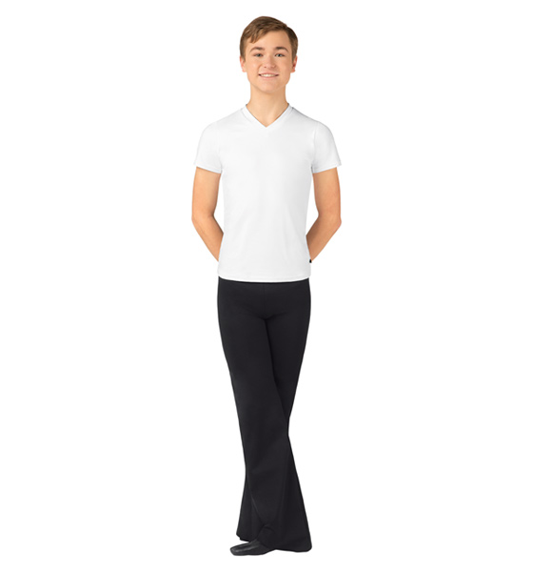
Bobby Mills- Andrew Stuaffer
Nice button up (Grey)
White shirt
Jazz pants
https://www.discountdance.com/dancewear/style_ME800.html?pid=26132&Shop=Style&&skey=&search=true&SortOrder=N&SID=1100437336
Shoes (Black)
http://www.dancewearsolutions.com/boys_and_men/shoes_and_tights/b80.aspx?position=1

Slide 15
Bebe BenzenHeimer- Morgaen Weir
Top
https://www.discountdance.com/dancewear/style_5173.html?pid=25998&Shop=Style&SID=1100679593
Leotard (black)
https://www.discountdance.com/dancewear/style_TH5112.html?pid=19030&Shop=Style&SID=1100681859
Dance shorts
Tights
shoes

Slide 16
Judy Turner-Emma Croft
Unitard
(Plum)
https://www.allaboutdance.com/dance-clothing/product-view/style_87120.html?SID=1100834943&mainCategory=BODYWEAR&styleOne=BALLETAAD&styleTwo=UNITARDSAAD&PageNumber=1&ageGroup=none#
2. (Eggplant)
http://www.dancewearsolutions.com/leotards/camisole/mt757n.aspx?position=2
Tights (skin color)
Legwarmers (grey)

Slide 17
Richie Walters- Jesse Kern
Tight tank top (white)
https://www.allaboutdance.com/dance-clothing/product-view/style_M407.html?SID=1100437219&mainCategory=mens-and-unisex&PageNumber=1&ageGroup=none
Shorts (Blue)
https://www.discountdance.com/dancewear/style_M192.html?pid=25306&Shop=Style&&skey=&search=true&SortOrder=N&SID=1100437336
Shoes ( tan)
http://www.dancewearsolutions.com/boys_and_men/shoes_and_tights/b80.aspx?position=1

Slide 18
Al Deluca- Laith Tabet
Shirt (dark green)
http://www.dancewearsolutions.com/6620.aspx
Pants (black)
https://www.allaboutdance.com/dance-clothing/product-view/style_M1000.html?SID=1100437219&mainCategory=mens-and-unisex&PageNumber=1&ageGroup=none#
Shoes ( black)
http://www.dancewearsolutions.com/boys_and_men/shoes_and_tights/b80.aspx?position=1

Slide 19
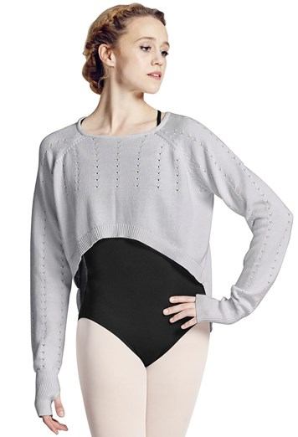
Kristine Deluca- Maddie Rohde
Leotard (dark green)
https://www.discountdance.com/dancewear/style_N5500.html?pid=10098&Shop=Style&&skey=&search=true&SortOrder=P&SID=1100655678
Sweater
http://www.dancewearsolutions.com/tops/tshirts/z6910.aspx?position=10
Tights (nude)
Shoes (nude)

Slide 20
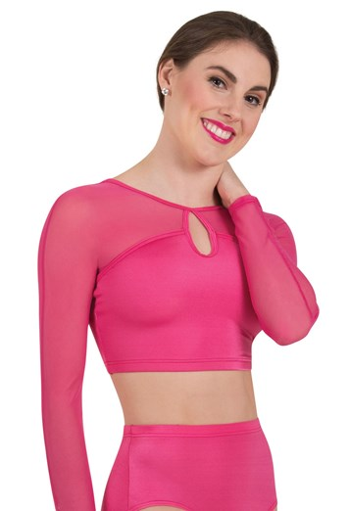
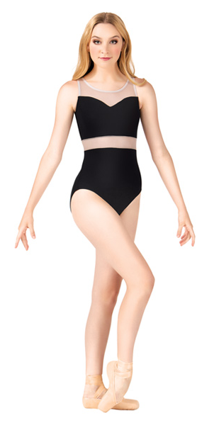
Val Clark- Marina Cox
Leotard
https://www.discountdance.com/dancewear/style_N8705.html?&pid=19171&Shop=Style&&skey=&search=true&SortOrder=P&SID=1101063010
Shoes (nude)
Tights (skin tone)
Top (black or pink)
http://www.dancewearsolutions.com/tops/p1014.aspx?position=47
Bottom
http://www.dancewearsolutions.com/pdp2/recommendations/p1015.aspx
or

Slide 21
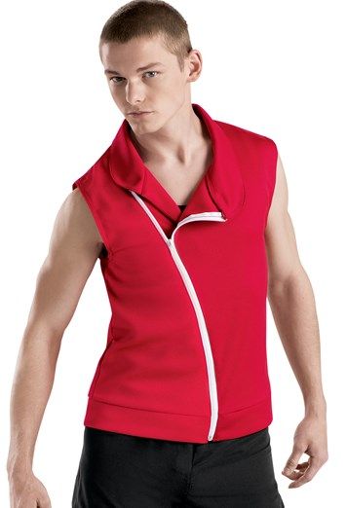
Paul San Marco- Shane boylan
Top (red)
http://www.dancewearsolutions.com/boys_and_men/7026.aspx?position=32
https://www.discountdance.com/dancewear/style_ME812.html?TopCat=&cat=&Shop=Style&SID=1100437336&search=true
Pants (black)
https://www.discountdance.com/dancewear/style_CL5002.html?pid=23802&Shop=Style&&skey=&search=true&SortOrder=N&SID=1100437336
Shoes (black)
http://www.dancewearsolutions.com/boys_and_men/shoes_and_tights/b80.aspx?position=1

Slide 22
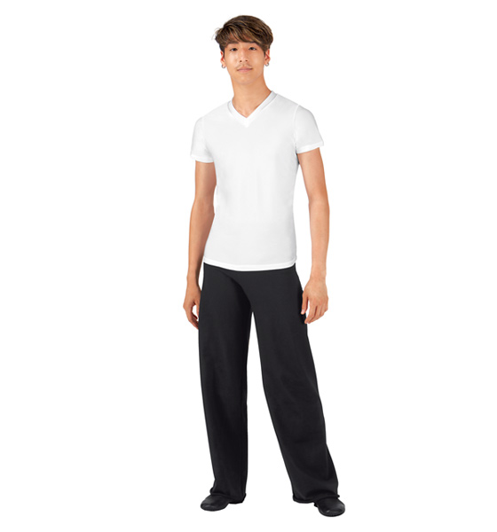
Mark Anthony – Seth Turner
Snug tank top (blue)
Pants (black)
https://www.discountdance.com/dancewear/style_CL5000.html?pid=23800&Shop=Style&&skey=&search=true&SortOrder=N&SID=1100437336
Shoes (black)
http://www.dancewearsolutions.com/boys_and_men/shoes_and_tights/b80.aspx?position=1

Slide 23
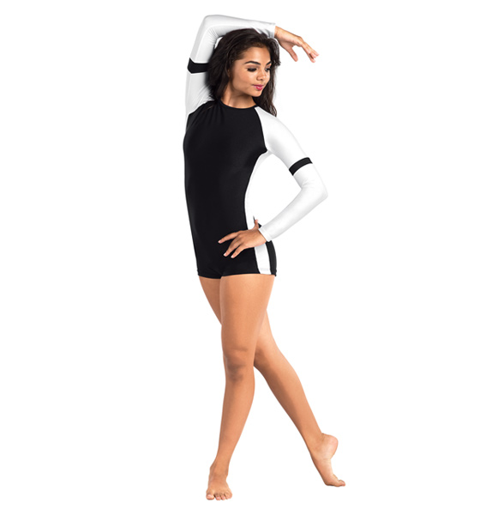
Diana Morales- Emily Wose
Unitard
https://www.discountdance.com/dancewear/style_BT5093.html?pid=24671&Shop=Style&&skey=&search=true&SortOrder=N&SID=1106751539
https://www.discountdance.com/dancewear/style_N8947.html?TopCat=&cat=&Shop=
Tights (skin tone)
Shoes (skin tone)
http://www.dancewearsolutions.com/shoes/b80.aspx?position=1

Slide 24
Frank-Dezmond
Muscle Shirt (white)
https://www.discountdance.com/dancewear/style_1257469.html?pid=25058&Shop=Style&&skey=&search=true&SortOrder=N&SID=1100437336
Shoes
http://www.dancewearsolutions.com/boys_and_men/shoes_and_tights/b80.aspx?position=1
Pants
https://www.discountdance.com/dancewear/style_ME800.html?pid=26132&Shop=Style&&skey=&search=true&SortOrder=N&SID=1100437336

Slide 25
Tricia-Oliva Bynum
Leotard ( Royal)
https://www.discountdance.com/dancewear/style_D5103.html?pid=3547&Shop=Style&SID=1100947793
http://www.dancewearsolutions.com/leotards/mt757n.aspx?position=16
Tight (skin toned)
Shoes (skin Toned)

Slide 26
Vicki-Josie
Leotard
http://www.dancewearsolutions.com/leotards/mt2435.aspx?position=14
https://www.discountdance.com/dancewear/style_N8805.html?pid=22275&Shop=Style&SID=1100947793
Tights (skin toned)
Shoe (skin toned)

Slide 27
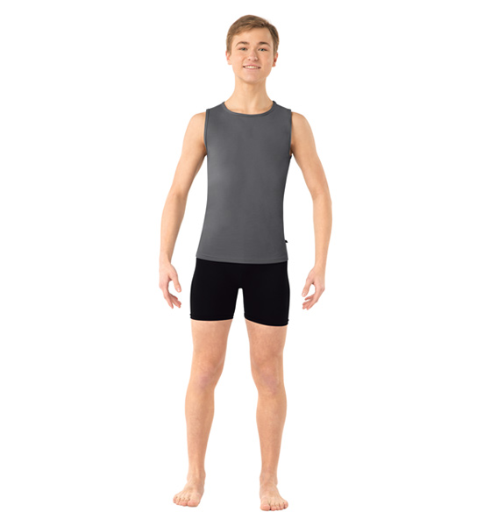
Roy – Aaron Callan
Headband
Shirt
https://www.allaboutdance.com/dance-clothing/product-view/style_P2205.html?SID=1100959507&mainCategory=mens-and-unisex&styleOne=TSHIRTSAAD&PageNumber=1&ageGroup=none#
Pants (black)
https://www.discountdance.com/dancewear/style_ME805.html?pid=26140&Shop=Style&SID=1100956097
https://www.allaboutdance.com/dance-clothing/product-view/style_M192.html?SID=1100958843&mainCategory=mens-and-unisex&styleOne=SHORTSAAD&PageNumber=1&ageGroup=none
Shoes (tan)
http://www.dancewearsolutions.com/boys_and_men/shoes_and_tights/b80.aspx?position=1

Slide 28
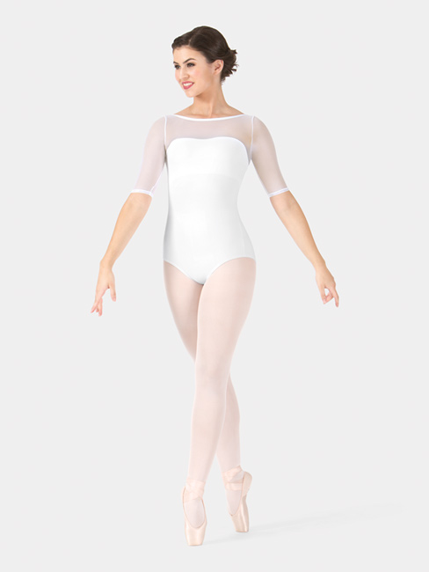
Jayden Lucas
Leotard (white)
https://www.allaboutdance.com/dance-clothing/product-view/style_N8628.html?SID=1107058324&mainCategory=BODYWEAR&styleOne=BALLETAAD&styleTwo=LEOTARDSAAD&PageNumber=1&ageGroup=none#
https://www.allaboutdance.com/dance-clothing/product-view/style_N8944.html?SID=1107058324&mainCategory=BODYWEAR&styleOne=BALLETAAD&styleTwo=LEOTARDSAAD&PageNumber=1&ageGroup=none#
Tights (white Or skin toned)
Shoes (skin toned)

Slide 29
Mara Blaylock
Leotard (pink)
https://www.discountdance.com/dancewear/style_M515L.html?pid=3346&Shop=Style&&skey=&search=true&SortOrder=P&SID=1107030952
https://www.allaboutdance.com/dance-clothing/product-view/style_TH5526.html?SID=1106878631&mainCategory=BODYWEAR&styleOne=BALLETAAD&styleTwo=LEOTARDSAAD&PageNumber=1&ageGroup=none#
Tights
Warm up pants, yoga pants
Shoes

Slide 30
Koeby Turner
Top (lime )
http://www.dancewearsolutions.com/boys_and_men/6620.aspx?position=0
Bottoms ( grey)
https://www.allaboutdance.com/dance-clothing/product-view/style_CL825.html?SID=1107086202&mainCategory=mens-and-unisex&PageNumber=1&ageGroup=none#
Shoes (tan)
http://www.dancewearsolutions.com/boys_and_men/shoes_and_tights/b80.aspx?position=1

Slide 31
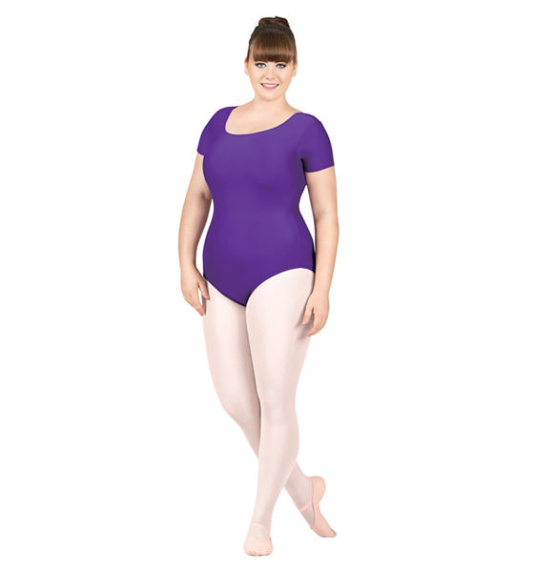
Tyler Tololatta
Leotard (purple)
https://www.discountdance.com/dancewear/style_D5102W.html?pid=4499&Shop=Style&&skey=&search=true&SortOrder=P&SID=1107030952
https://www.discountdance.com/dancewear/style_BT5171.html?pid=25496&Shop=Style&&skey=&search=true&SortOrder=P&SID=1107030952
Tights
Shoes
Warm up

Slide 32
Alexis Hollingsworth
Leotard (dark blue)
http://www.dancewearsolutions.com/mt9579.aspx
https://www.discountdance.com/dancewear/style_CC201.html?pid=6456&Shop=Style&&skey=&search=true&SortOrder=P&SID=1106970653
Tights(skin)
Shoes (skin)

Slide 33
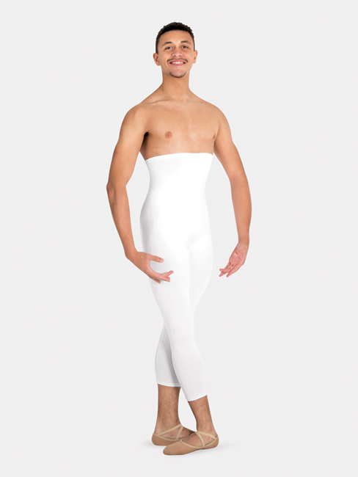
Chris Breder
Top or a loose crop top
https://www.allaboutdance.com/dance-clothing/product-view/style_M407.html?SID=1107095224&mainCategory=mens-and-unisex&styleOne=TSHIRTSAAD&PageNumber=1&ageGroup=none
Bottom
https://www.allaboutdance.com/dance-clothing/product-view/style_M205.html?SID=1107086202&mainCategory=mens-and-unisex&PageNumber=1&ageGroup=none
Shoes(tan)
http://www.dancewearsolutions.com/boys_and_men/shoes_and_tights/b80.aspx?position=1

Slide 34
Elijah Hamm
Unitard (blue)
https://www.discountdance.com/dancewear/style_ME826.html?pid=26152&Shop=Style&&skey=&search=true&SortOrder=N&SID=1107085056
Shoes (tan)
http://www.dancewearsolutions.com/boys_and_men/shoes_and_tights/b80.aspx?position=1

Slide 35
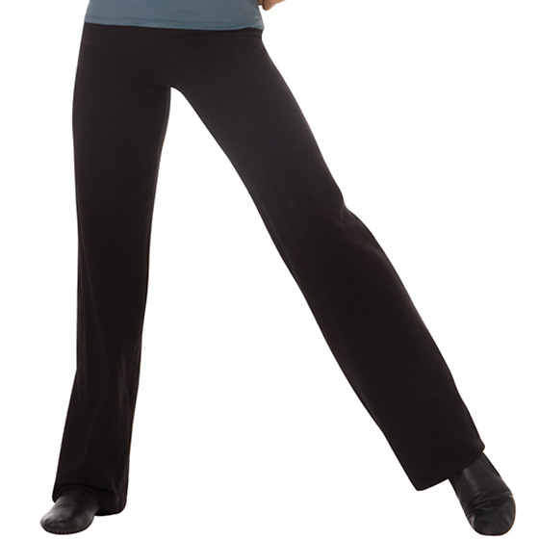
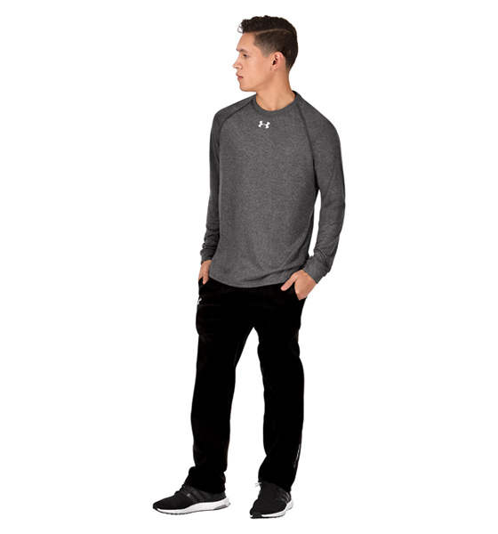
Colby Synder
Top- long sleeve athletic shirt
Bottoms
https://www.discountdance.com/dancewear/style_M191.html?pid=8664&Shop=Style&&skey=&search=true&SortOrder=N&SID=1107096325
Shoes (Tan)
http://www.dancewearsolutions.com/boys_and_men/shoes_and_tights/b80.aspx?position=1

Slide 36
Faithlin Hunter
Leotard (French Mauve)
http://www.dancewearsolutions.com/leotards/mt8125-clearance.aspx?position=55
http://www.dancewearsolutions.com/leotards/mt7827-clearance.aspx?position=23
Tights( skin)
Shoes (skin)
Warm up

Slide 37
Alyssa Mazonne
Leotard (sage)
https://www.discountdance.com/dancewear/style_N8561.html?pid=8198&Shop=Style&&skey=&search=true&SortOrder=P&SID=1106770096
https://www.allaboutdance.com/dance-clothing/product-view/style_M207LD.html?SID=1106878631&mainCategory=BODYWEAR&styleOne=BALLETAAD&styleTwo=LEOTARDSAAD&PageNumber=1&ageGroup=none#
Tights
Warm up sweater
Shoes (nude)

Slide 38
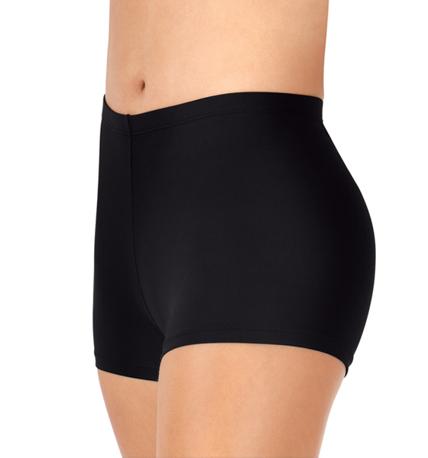
Abby Lastinger
Leotard
https://www.discountdance.com/dancewear/style_NAB107.html?TopCat=&cat=&Shop=
Bottoms black shorts
https://www.discountdance.com/dancewear/style_SSBC15.html?TopCat=&cat=&Shop=
Black shrug
https://www.discountdance.com/dancewear/style_M1105.html?TopCat=&cat=&Shop=Style&SID=1107068420&search=true
Tights (nude)
Shoes ( nude)

Slide 39
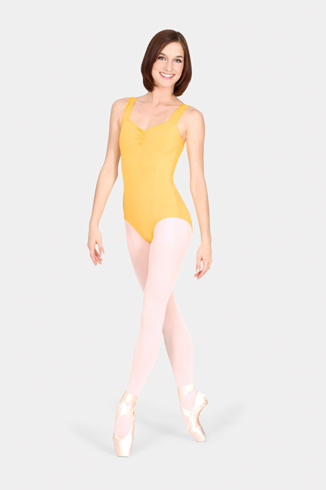
Camryn Youngblood
Leotard (buttercup)(bronze)
https://www.discountdance.com/dancewear/style_N8601.html?pid=8578&Shop=Style&SID=1106966486
https://www.allaboutdance.com/dance-clothing/product-view/style_N5501.html?SID=1106878631&mainCategory=BODYWEAR&styleOne=BALLETAAD&styleTwo=LEOTARDSAAD&PageNumber=1&ageGroup=none#
Warm up pants
Tights (nude)
Shoes (nude)

Slide 40
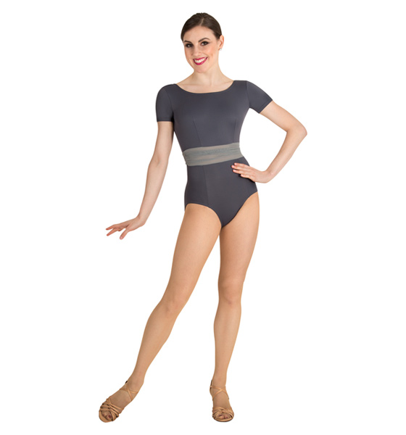
Alyssa Gross
Leotard (grey)
https://www.allaboutdance.com/dance-clothing/product-view/style_N8562.html?SID=1106878631&mainCategory=BODYWEAR&styleOne=BALLETAAD&styleTwo=LEOTARDSAAD&PageNumber=1&ageGroup=none#
https://www.discountdance.com/dancewear/style_P1010.html?TopCat=&cat=&Shop=
Tights
Shoes
Warm up pants and jacket

Slide 41
Whitney Harris
Leotard (Emerald)
http://www.dancewearsolutions.com/leotards/mt8326-clearance.aspx?position=61
http://www.dancewearsolutions.com/leotards/l8807.aspx?position=16
Tights (nude)
Shoes (nude)
legwarmers

Slide 42
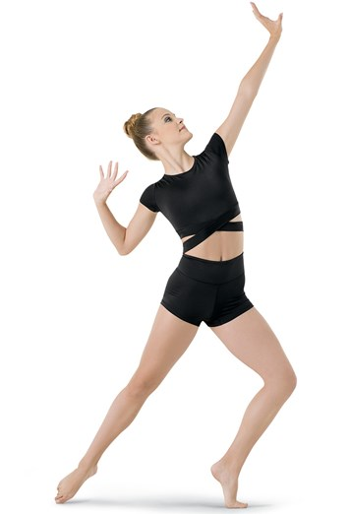
Emily Johnson
Top (black )
http://www.dancewearsolutions.com/tops/mt9365.aspx?position=24
Bottom
http://www.dancewearsolutions.com/pdp2/recommendations/mt2764.aspx
Shoes (nude)
Tights(nude)

Slide 43
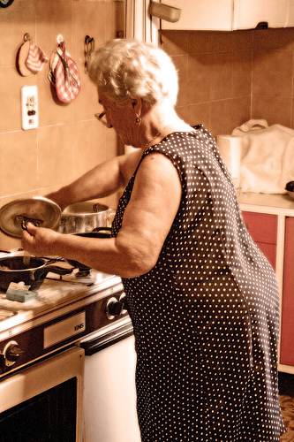
Mike's Grandmother- Lila Ramon
You will be very Pulp
Old lady boobs
Stocking
Apron
Frumpy looking dress

Slide 44
Rosalie- Jayden Lucas
Ruffles long sleeve shirt
White stockings
Black flats
Velveteen skirt

Slide 45
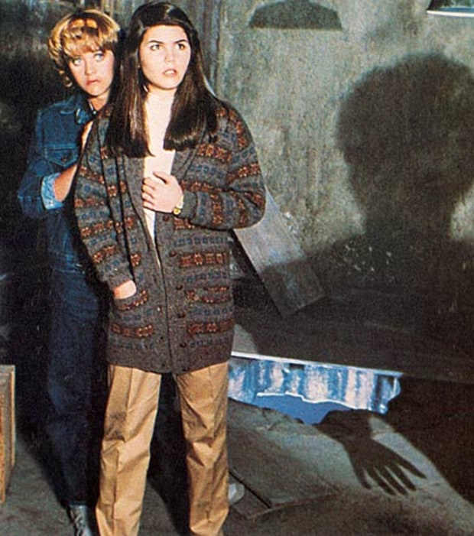
Bobby' mother- Destiny Cusic
Mom jeans
Big hair
Turtle neck
Cardigan
You’re a mother from the 80s

Slide 46
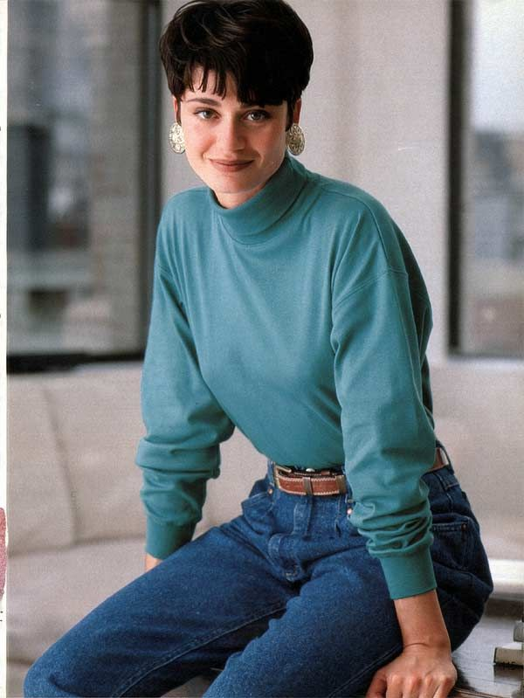
Shelia Mother –Faithlin Hunter
80's mother
Sweater tucked in to mom jeans

Slide 47
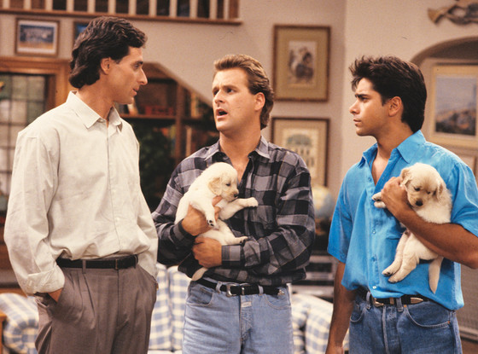
Shelia's Father- Chris Breder
Jeans
Button down shirt
vest

Slide 48
Salesman- Aaron Callan
Printed plaid jacket
Dress pants
Dress shirt
Dress shoes
Tie

Slide 49
Young Kristine
corduroy suspender jeans
Print blouses
Black shoe's

Slide 50
Theater teacher- Chris Breder
Flannel
Jeans
Tennis shoes
You will look like Price basically

Slide 51
Theater students
You will be wearing past show shirt so if you do not have one. Please tell so I can find one for you. No one should be wearing the same show shirt.
Jeans, skirts

Slide 52
AT THE BALLET- female dancers
Outfit
https://www.allaboutdance.com/dance-clothing/product-view/style_TH4062.html?SID=1100980630&mainCategory=BODYWEAR&styleOne=PERFORMAAD&styleTwo=COSTUME&PageNumber=1&ageGroup=none#
Ballet slippers
https://www.allaboutdance.com/dance-clothing/product-view/style_S1C.html?SID=1107076741&mainCategory=shoes&styleOne=BALLETSHOEAA&styleTwo=BALLETSLIPAA&PageNumber=1&ageGroup=none#
Tights white

Slide 53
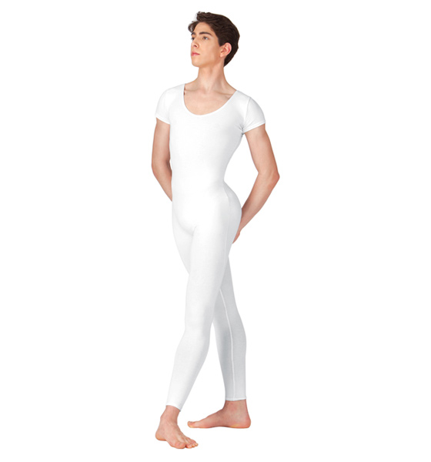
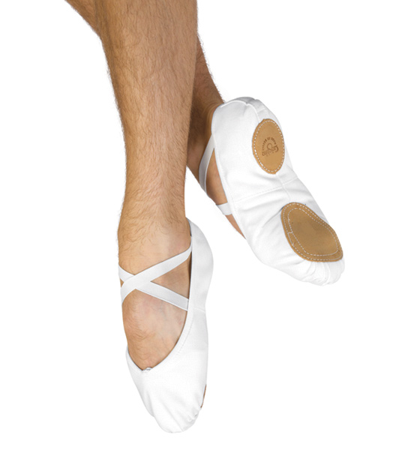
AT THE BALLET male dancer
Unitard
https://www.discountdance.com/dancewear/style_CL889.html?pid=23340&Shop=Style&&skey=&search=true&SortOrder=N&SID=1101015998
Shoes
https://www.discountdance.com/dancewear/style_MCP.html?pid=1778&Shop=Style&&skey=&search=true&SortOrder=N&SID=1101015998

